Slide 1


LATERAL CONTROL OF AUTONOMOUS VEHICLES
Ameya Deshpande
Department of Mechanical Engineering

Slide 2
Motivation
From 2005 to 2007, from over 5000 crashes studied, more than 10% of the vehicles failed to stay in proper lane and 22% percent of vehicles ran off the edge of a roadway.
Robust lateral control has a huge potential to reduce the crashes for increased road safety.

Slide 3
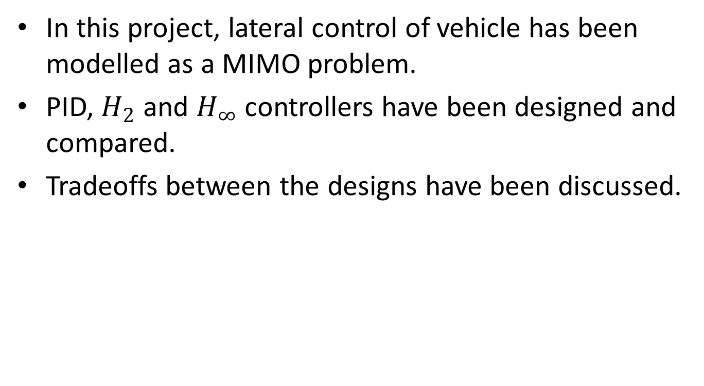
Introduction
In this project, lateral control of vehicle has been modelled as a MIMO problem.
PID, $H_{2}$ and $H_{∞}$ controllers have been designed and compared.
Tradeoffs between the designs have been discussed.

Slide 4
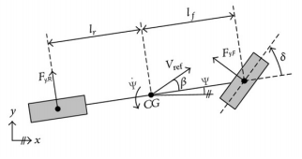
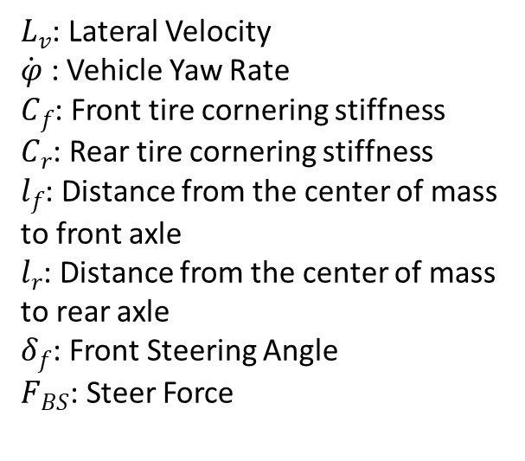
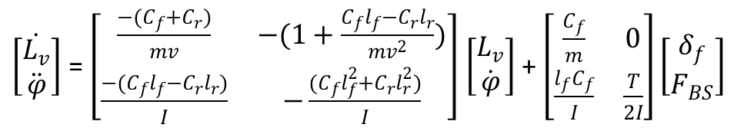
State Equations
$L_{v}$: Lateral Velocity
$\dot{φ}$ : Vehicle Yaw Rate
$C_{f}$: Front tire cornering stiffness
$C_{r}$: Rear tire cornering stiffness
$l_{f}$: Distance from the center of mass to front axle
$l_{r}$: Distance from the center of mass to rear axle
$δ_{f}$: Front Steering Angle
$F_{BS}$: Steer Force
$\left[\begin{aligned}\dot{L_{v}} \\ \ddot{φ}\end{aligned}\right]$ = $\left[\begin{matrix}\frac{−(C_{f}+C_{r})}{mv} & −(1+\frac{C_{f}l_{f}−C_{r}l_{r}}{mv^{2}}) \\ \frac{−(C_{f}l_{f}−C_{r}l_{r})}{I} & −\frac{(C_{f}l_{f}^{2}+C_{r}l_{r}^{2})}{I}\end{matrix}\right]$ $\left[\begin{aligned}L_{v} \\ \dot{φ}\end{aligned}\right]$ + $\left[\begin{matrix}\frac{C_{f}}{m} & 0 \\ \frac{l_{f}C_{f}}{I} & \frac{T}{2I}\end{matrix}\right]\left[\begin{aligned}δ_{f} \\ F_{BS}\end{aligned}\right]$
For the analysis, $l_{f}$ = 1m, $l_{r}$ = 1.5m, $C_{f}$ = 55000 N/rad, $C_{r}$ = 45000 N/rad, m = 1000 kg, I = 1500 kg/$m^{2}$

Slide 5
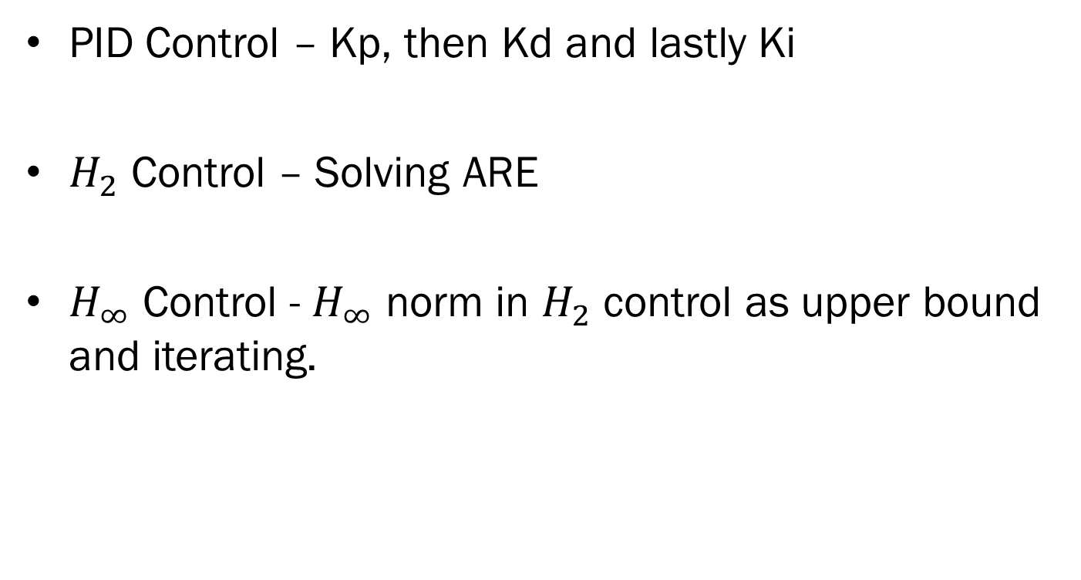
Procedure
PID Control – Kp, then Kd and lastly Ki
$H_{2}$ Control – Solving ARE
$H_{∞}$ Control - $H_{∞}$ norm in $H_{2}$ control as upper bound and iterating.

Slide 6
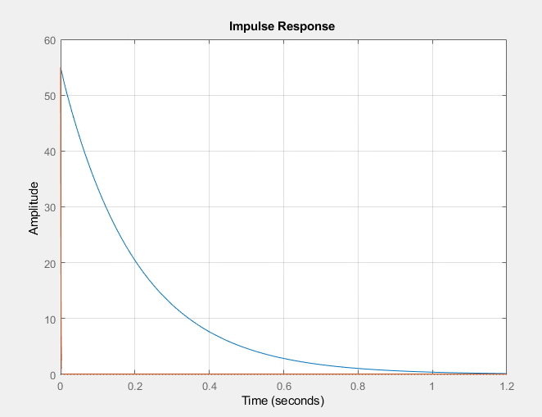
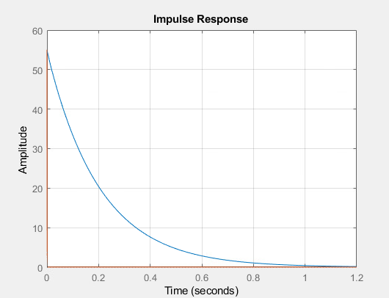
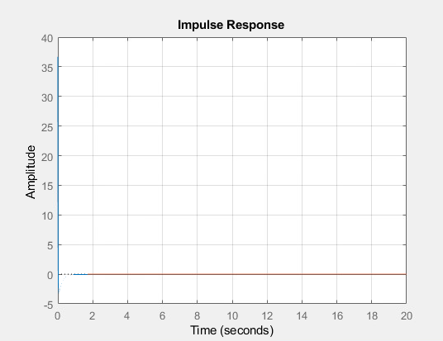
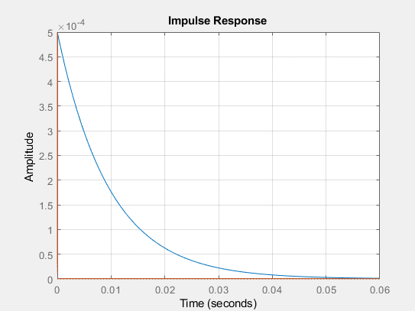
Control System Design - 1
PID Control

Slide 7
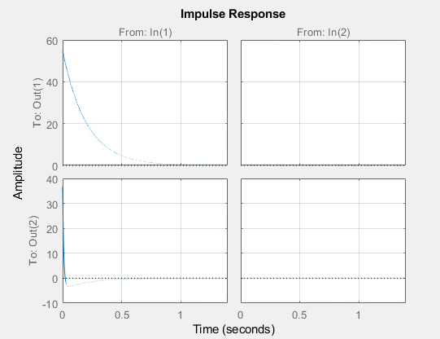
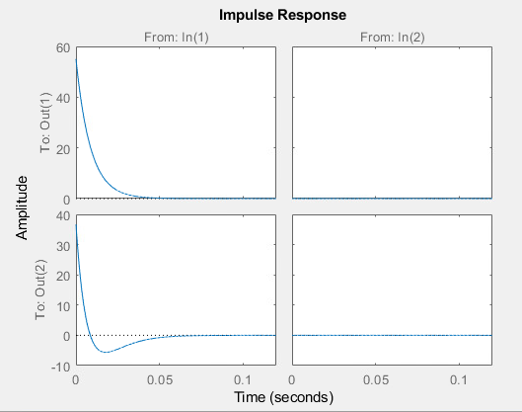

Control System Design - 2
$H_{2}$ Control
Uncontrolled
Controlled

Slide 8

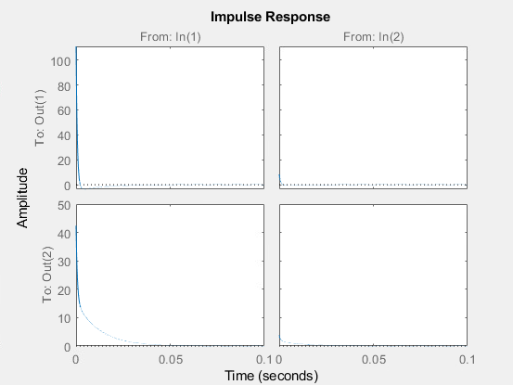

Control System Design - 3
$H_{∞}$ Control
Uncontrolled
Controlled

Slide 9
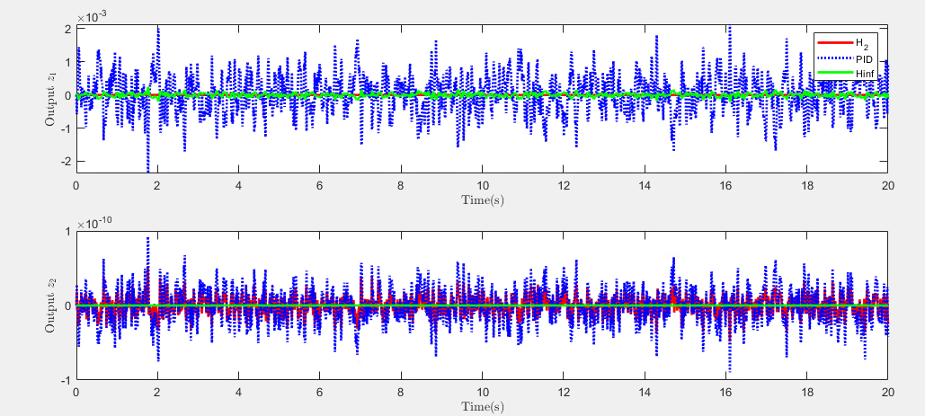
Response to Disturbances
$H_{2} and H_{∞}$performed far better then PID to disturbances as expected

Slide 10
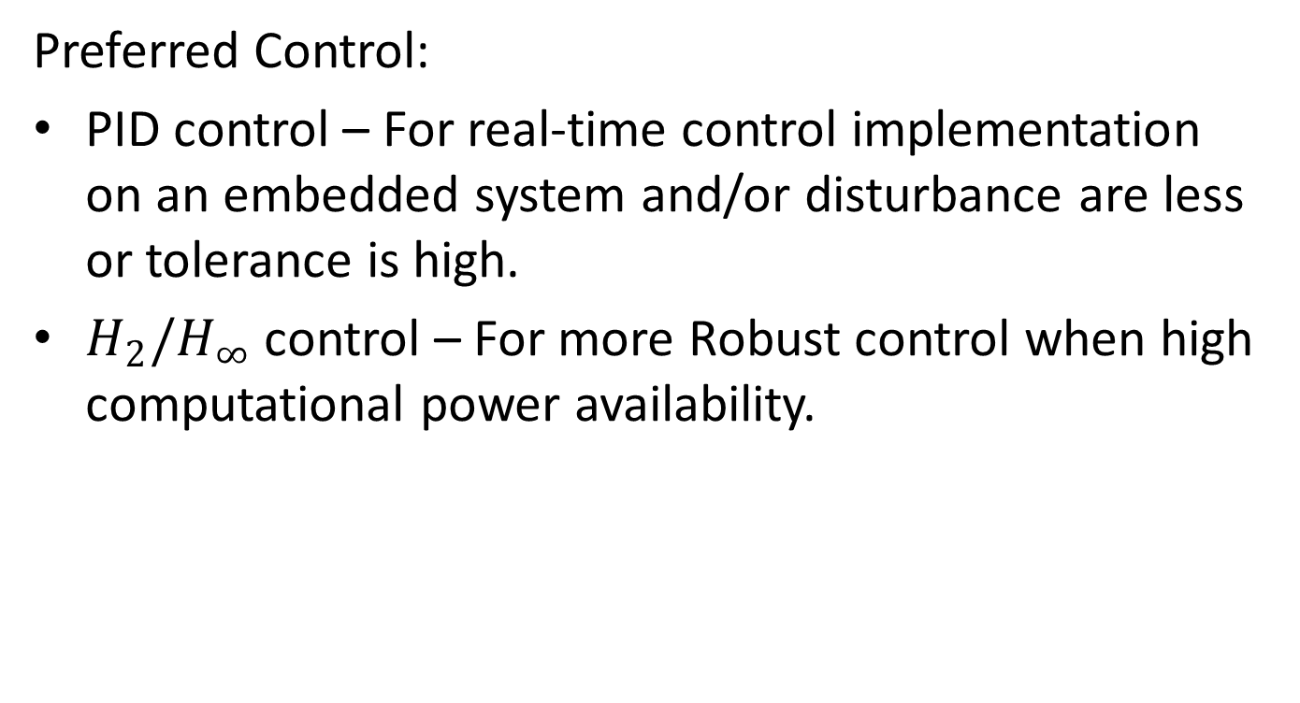
Conclusion
Preferred Control:
PID control – For real-time control implementation on an embedded system and/or disturbance are less or tolerance is high.
$H_{2}/H_{∞}$ control – For more Robust control when high computational power availability.

Slide 11
THANK YOU FOR YOUR ATTENTION

